Slide 1
Eight Proactive Classroom Management Strategies
That Work in Any Classroom
Mike Roberts
Slides - https://bit.ly/3l5UZEF
Handout - https://bit.ly/3oZaL6D

Slide 2
A Review of Educational Research analysis of 46 studies found that strong teacher-student relationships were associated in both the short- and long-term with improvements on practically every measure schools care about: higher student academic engagement, attendance, grades, fewer disruptive behaviors and suspensions, and lower school dropout rates. Those effects were strong even after controlling for differences in students' individual, family, and school backgrounds. (Education Week, November 1, 2020).
Teachers benefit, too. A study in the European Journal of Psychology of Education found that a teacher's relationship with students was the best predictor of how much the teacher experienced joy versus anxiety in class. (Education Week, November 1, 2020).
What the Research Says About Strong Teacher-Student Relationships

Slide 3
What My 22 Years as a Teacher Says
From my experience, the best classroom management strategies aren’t reactive in nature (talking to students after class, calling home, removing them from the classroom), but rather are of the proactive variety.
They are the kind of techniques that are established early, and continually built upon, a mutual respect between teacher and student.

Slide 4
Each of the following eight strategies will be followed by three simple-yet-effective techniques that will improve your relationships with students.
Additionally, each strategy will also identify a teacher from tv or the movies who exemplify the concept being presented.
So without further delay, here are eight proactive classroom management strategies that work in any classroom!
The Strategies and the Teachers

Slide 5
Say your students’ names often
When class starts
When taking roll
Every time they share an idea
“I'm a teacher. That's what it says on my locker, "Mr. Kotter, teacher." And I'm teaching a bunch of students called Sweathogs. Now, contrary to popular opinion, Sweathogs are not dumb. I mean, a dumb person does not think of a way to make it rain in the gymnasium.”
Image from the famouspeople.com

Slide 6
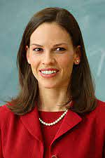
Compliment and thank students often
About their work/effort
About their positive choices
Thank them at the end of class
“I am not letting you fail. Even if that means coming to your house every night until you finish the work. I see who you are. Do you understand me? I can see you. And you are not failing.”

Slide 7
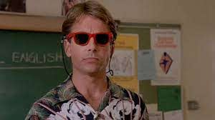
Talk to students throughout the day
During class
In the halls
At lunch / after school
“But look, there's more going on here than test scores and grades. You all worked hard and improved.”
Image from wearesecondonion.com

Slide 8
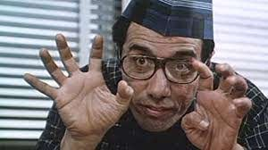
Let students assess you/your teaching often
After class
After a unit
At the end of the quarter
Image from imdb.com
“You're going to work harder here than you've ever worked anywhere else. And the only thing I ask from you is ganas. Desire.”

Slide 9
Let students self-assess
On assignments/tests
On behavioral issues
With their attitudes
"It’s high time your grandmother learned to be proud of the grandson she’s got, rather than the one she thinks she ought to have."

Slide 10
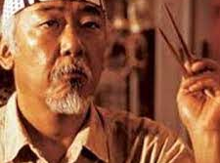
Give students choices
In where they sit
On assignments
In picking their groups
“Lesson not just karate only. Lesson for whole life. Whole life have a balance. Everything be better.”
Image from thekaratekid.fandom.com

Slide 11
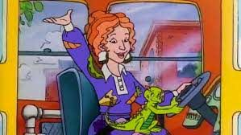
Show your students that you trust them
Self assessments
Take home exams
Bathroom policy
“Take chances, make mistakes, and get messy!”

Slide 12
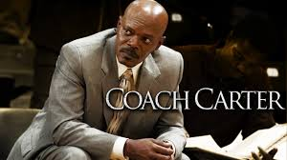
Include some “easy” days
Fun review games
Catch up days
End of quarter celebrations
“You said we’re a team. One person struggles, we all struggle. One person triumphs, we all triumph.”

Slide 13
If you proactively empower your students a little bit each day, your students will positively react to what you’re doing.
I have never regretted giving a student a second chance...but I have regretted not giving them a second chance.

Slide 14
Contact Information
Mike Roberts
Website: thebaldenglishteacher.com
Twitter: @BaldRoberts
Email:thebaldenglishteacher@gmail.com
Slides - https://bit.ly/3l5UZEF
Handout - https://bit.ly/3oZaL6D

